Slide 1

How helpful are reviews?
Exploring & classifying Amazon.com electronics reviews using helpfulness ratings using big (& small) data tools
Neal Staalberg & Kirby Hood
IST 652 Scripting for Data

Slide 2

Purpose of Investigation
Determining the feasibility of predictive analytics using reviews text from Amazon.com on electronic products to determine the relative helpfulness of the review.
3 classes of reviews created which have the potential to provide critical information for potential customers and purchases of products.
Unhelpful
Neutral
Helpful
Amazon reviews take weeks to months to accumulate, and even longer for users to determine if a review was helpful or not.
Prediction of reviews customers will find helpful can help in promoting reviews which may be beneficial for products as well as potential retailers and consumers.

Slide 3
Analysis Questions
Can a prediction model generate the same classification of helpfulness as dozens or hundreds of prospective buyers?
Can the prediction model of reviews, either helpful or not be applied to other businesses and their products to compare how their product reviews are similar to those from Amazon?
Can the predictive model trained on electronics reviews generalize well to products in other categories?
Can a modestly accurate classification algorithm provide keywords that can guide or add value to the current human review process from existing Amazon shoppers?

Slide 4
Scope
Reviews from Amazon.com
Electronics category : 1,689,188 reviews*
Collected between May 1996 - July 2014
Reviews within scope : 725,961
Stratified sampling reviews used (roughly equal helpfulness classes) : 330,308
Sourced by Julian McAuley, UCSD
* Some total rating of helpfulness (reviews not rated as helpful or not helpful not evaluated) i.e. reviews exist but no one has rated the reviews as helpful/unhelpful

Slide 5
Data Preparation
Convert helpfulness ratings into categorical data
Exclude reviews with no ratings
Find ratio of helpful/total ratings
Transform helpful/total ratings -> categorical variable (i.e. unhelpful(0), neutral(1), helpful(2)
Class balancing
Stratified sampling by categorical variable (unhelpful, neutral, positive)
Text processing
Tokenize
Remove stop words
Hash
Inverse document frequency

Slide 6
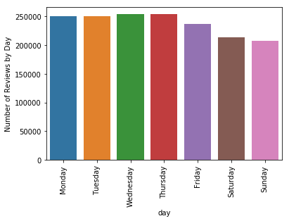
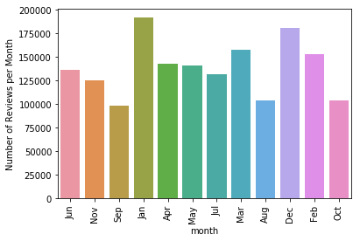
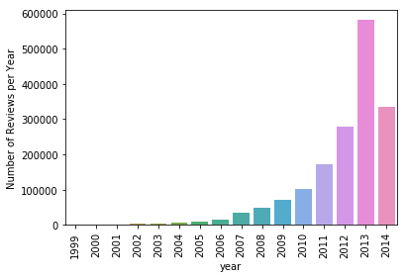
Data Exploration: Frequency
Number of reviews by day of week
Number of reviews by month
Number of reviews by year

Slide 7
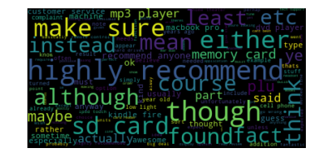
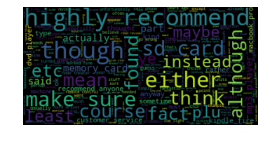
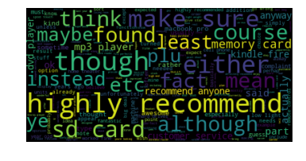
Data Exploration: Word Clouds
Helpful
Neutral
Unhelpful

Slide 8
Further Data Exploration
Expand beyond n-gram processing as word cloud shows that ‘highly recommend’ was significantly present in three classes
Exclude text specifically referencing the item i.e. ‘sd card’ in the text of a review for a sd card likely doesn’t correlate with the classification of the review
Higher dimension modeling : Transition from classical ML to neural networks to address high dimensionality
Weighting of reviews by total review ratings for learning of model

Slide 9
Closer Look
Helpful
Neutral
Unhelpful

Slide 10
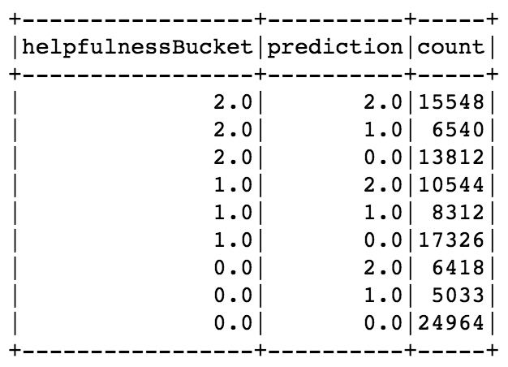
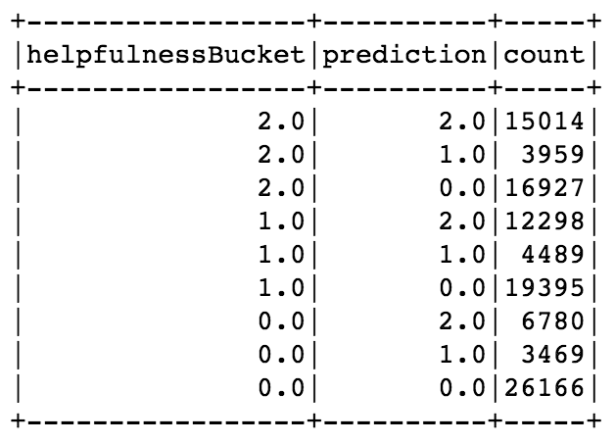
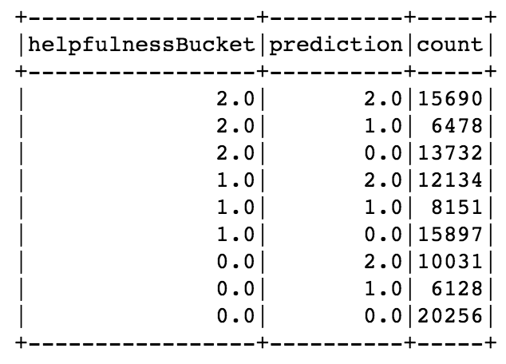
Results
Logistic Regression Predictions: (Best)
Accuracy: 45%
RF Predictions (OK)
NB Predictions (-4% from best)
Accuracy: 42%
Accuracy: 41%

Slide 11
Conclusion
There is value in doing classification based on the ratio of helpful/total ratings.
However, additional work is required to expand beyond classical machine learning methods and to apply complex text analysis methods (i.e. syntaxNet) to determine the context in which the words were written in relation to the sentence.
Currently there is not a weighting method implemented for the reviews.
i.e. information learned from a review with 1 helpful/ 2(helpful || unhelpful) is evaluated the same as 500 helpful / 1000(helpful || unhelpful)
Special attention should be given to reviews where the actual class was the opposite class of that predicted i.e. predicted 0 when actually 2 and vice versa.

Slide 12
Data Source
Data Acquisition: Electronics section from
http://jmcauley.ucsd.edu/data/amazon/
Reference:
Ups and downs: Modeling the visual evolution of fashion trends with one-class collaborative filtering R. He, J. McAuley WWW, 2016

Slide 13
Software & Libraries
Jupyter notebook
PySpark - Spark 2.4 on Kubernetes in Docker
RegexTokenizer
Tokenizer
IDF aka Inverse Document Frequency
Hashing
StopWordsRemover
Pipeline
RandomForestClassifier
Rodeo
numpy
pandas
seaborn
python
JSON
calendar
Matplotlib
collections
gzip
Urllib
datetime

Slide 14
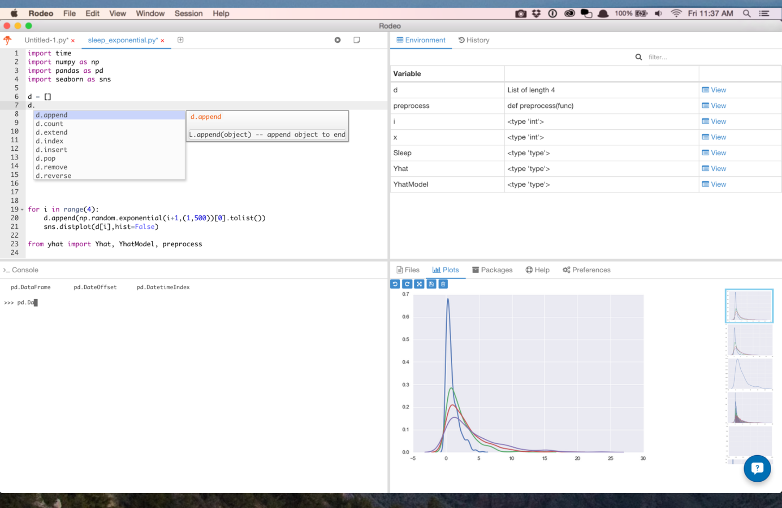
Software & Libraries (continued)
https://www.yhat.com/products/rodeo

Slide 15
Software & Libraries (continued)
Docker Community Edition
https://store.docker.com/editions/community/docker-ce-desktop-windows
Docker Image
https://hub.docker.com/r/alexmilowski/jupyter-spark-2.4.0/tags/
https://spark.apache.org/downloads.html
Spark 2.3 is most recent newest version of Spark. * Spark 2.4 hasn’t been released as of (2018-09-14) - minimal coding differences between 2.3 documented API and 2.4
Kubernetes supported as of Spark 2.3

